Slide 1
Digital Portfolio
STUDENT NAME: VISWANATHAN T
REGISTER NO AND NMID: 222406209/asunm1397222406209
DEPARTMENT: BSC CS WITH DS
COLLEGE: COLLEGE/ UNIVERSITY

Slide 2
PROJECT TITLE
Creative Portfolio Overview

Slide 3


AGENDA
Problem Statement
Project Overview
End Users
Tools and Technologies
Portfolio design and Layout
Features and Functionality
Results and Screenshots
Conclusion
Github Link
3/21/2024 Annual Review

Slide 4

PROBLEM STATEMENT
Begin by clarifying the problem your portfolio project tackles. It might be something like:
"Inefficient data-driven decision-making due to scattered information and lack of clear visualization."
Or perhaps: "Many small businesses struggle to monitor sales trends in real time and derive actionable insights."

Slide 5

PROJECT OVERVIEW
Summarize what the project is about:
Objective: Build a data analytics dashboard/web app to centralize data insights.
Scope: Collect and process data (maybe from CSVs, APIs), analyze key metrics, and display them via interactive charts and filters.

Slide 6

WHO ARE THE END USERS?
Identify who benefits from your project. Examples might include:
Business owners needing real-time sales and performance insights.
Data-savvy managers wanting visual financial or operational dashboards.
Recruiters or hiring managers, if you're aiming to showcase capabilities.

Slide 7

TOOLS AND TECHNIQUES
List the tools and technologies you used. Typical stack could include:
Frontend: Framework like React or plain HTML/CSS/JavaScript (or built via Lovable).
Backend/data: Python (Pandas), SQL, APIs, CSV imports.
Visualization: Libraries like Plotly, D3.js, or BI tools such as Power BI, Tableau, or built-in Lovable widgets.
Hosting & Collaboration: GitHub for version control, and deployment via Netlify, Vercel, or Lovable’s built-in features.
Others: Supabase for auth or database; Git for version history and showcase.

Slide 8
POTFOLIO DESIGN AND LAYOUT
Describe how the portfolio is presented visually and structurally:
A clean landing page (“About Me”) introducing your skills and goals.
Navigation bar linking to Projects, Skills, Contact, and GitHub.
Project detail pages containing:
Problem statement
Visuals of dashboards or charts
Technical breakdown
Key results and screenshots.
Consistent typography, spacing, and branding—makes it professionally appealing.a
8

Slide 9
FEATURES AND FUNCTIONALITY
Highlight what your app or portfolio allows users to do. Possible bullet points:
Interactive charts—line graphs for trends, bar charts for comparisons, filters by date or category.
Dashboard controls, e.g., selecting data range or toggling metrics.
Automated data updates—maybe via scheduled scripts or API calls.
Export/reporting functions, such as downloading charts or summary tables.

Slide 10

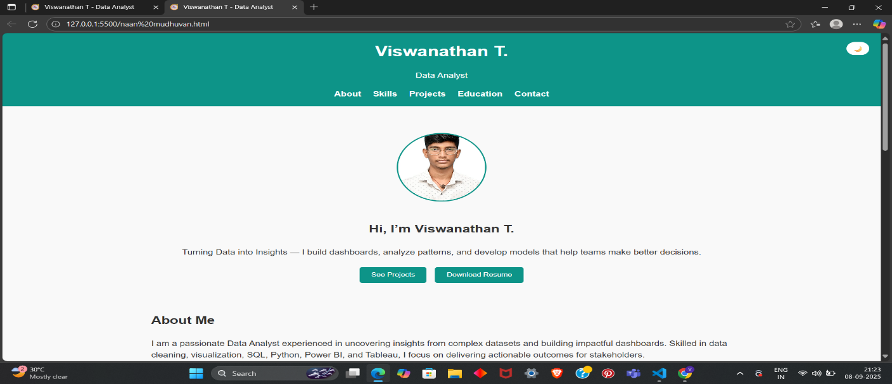
RESULTS AND SCREENSHOTS
This section is all about visual impact:
Embed a screenshot of your dashboard, annotated with key insights.
Include actual data outcomes—e.g., “Identified a 25% monthly sales spike in product category A.”
Show before/after comparison or highlight how the tool simplified decision-making.
Explain significance: did this help optimize inventory, budgets, or marketing?
3/21/2024 Annual Review
10

Slide 11
CONCLUSION
Wrap up with key takeaways:
Reflect on what you accomplished: e.g., built a functional analytics dashboard from scratch.
Highlight skills gained: data cleaning, visualization, user-focused design, deployment.
Note next steps—maybe adding user authentication, automated data pipelines, or mobile responsiveness.
Express how this project supports your broader career goal: showcasing your data analyst capabilities in real-world scenarios.
11

